Slide 1
Chapter 5: Globally 3*-connected graphs

Slide 2
Figure 5-1

Slide 3
Figure 5-2

Slide 4
Figure 5-3

Slide 5

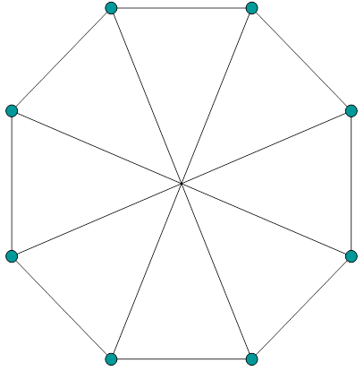

Figure 5-4

Slide 6


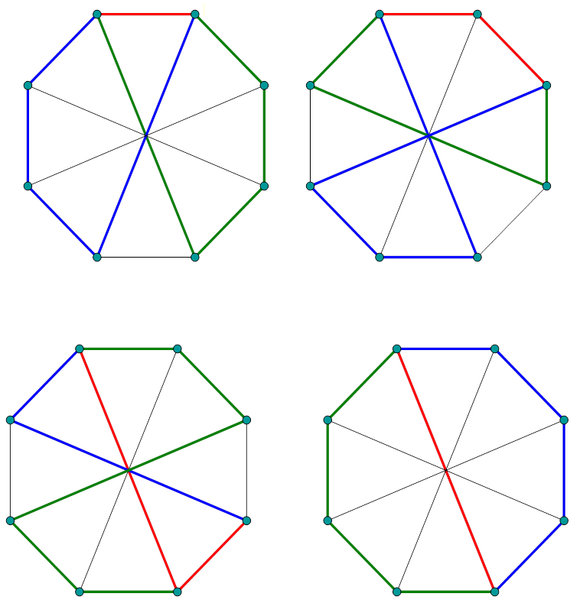




Slide 7
Recall that a Hamiltonian connected graph is a graph such that there is a path passing through all the vertices between any two vertices. A Hamiltonian graph is a graph such that there are two internal disjoint paths spanning all the vertices between any two vertices (see Figure 5-2, where the blue and green lines together form a Hamiltonian cycle of the graph). In this chapter, we are dealing with graphs with three internal disjoint paths traveling through all the vertices between any given two vertices.
We call a graph with k internal disjoint paths spanning all the vertices between any two vertices a k*-connected graph. In particular, a Hamiltonian connected graph is 1*-connected graph and a Hamiltonian graph is a 2*-graph. In this chapter, we are considering cubic 3*-connected graphs. Such graphs are also called globally 3*-connected graphs.

Slide 8
It is interesting to note that every globally 3*-connected graph is a 1-fault tolerant Hamiltonian graph. The proof is simple.
Figure 5-6

Slide 9
Suppose that some edge is faulty (Figure 5-7).
Figure 5-7

Slide 10
Since the graph in Figure 5-6 is globally 3*-connected, there are three internally disjoint paths between x and y (Figure 5-8).
Figure 5-8

Slide 11
Now, we must prove that every globally 3*-connected graph is 1-vertex fault tolerant Hamiltonian. Suppose that some vertex is faulty as shown in Figure 5-9.
Figure 5-9

Slide 12
Since the graph in Figure 5-6 is globally 3*-connected, there are three internally disjoint paths between y and z shown in Figure 5-10.
Figure 5-10

Slide 13
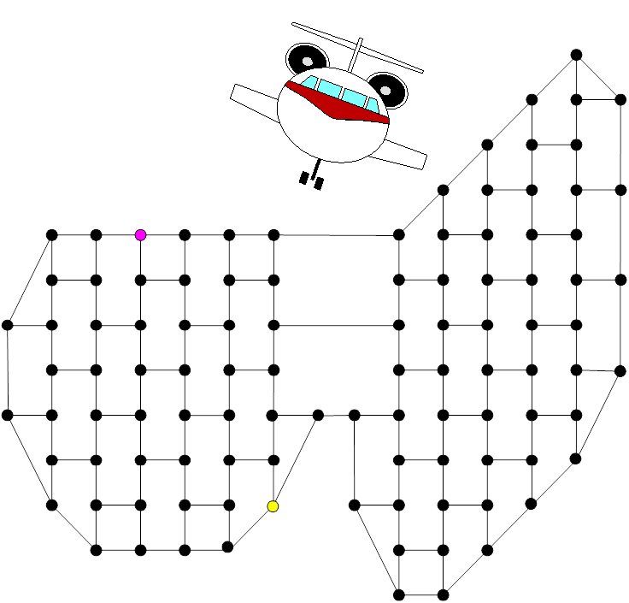


3-join.
Figure 5-11

Slide 14
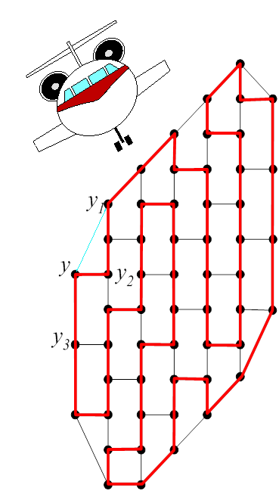
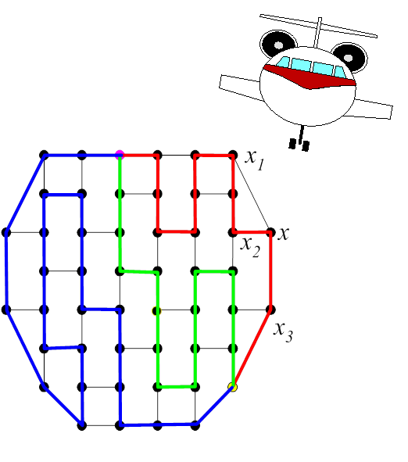



Figure 5-12
Figure 5-13

Slide 15
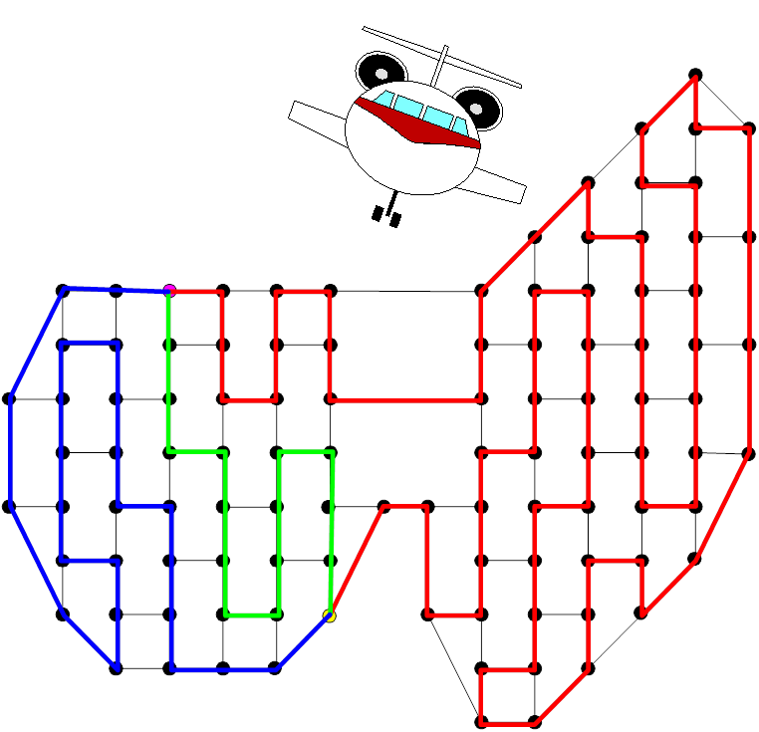

Figure 5-14

Slide 16
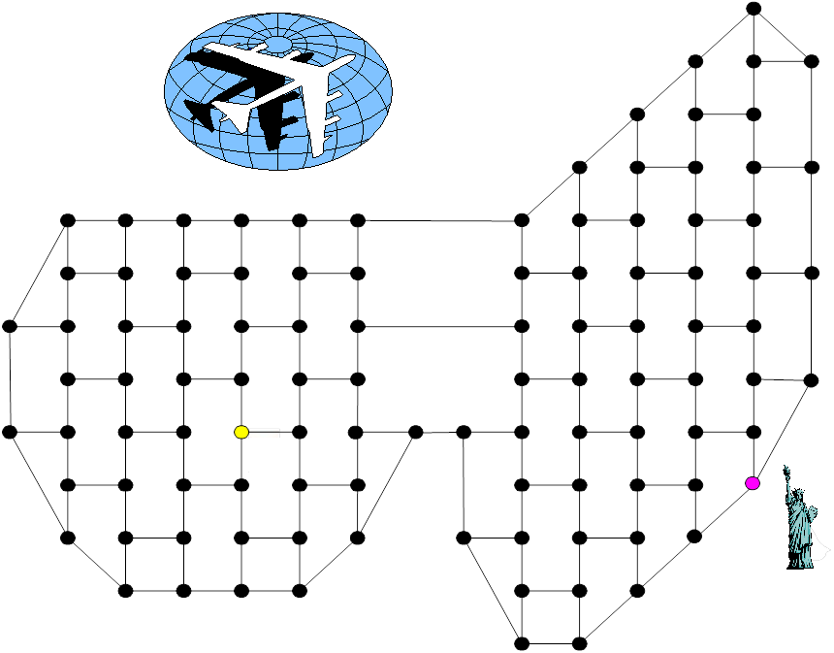

Figure 5-15

Slide 17
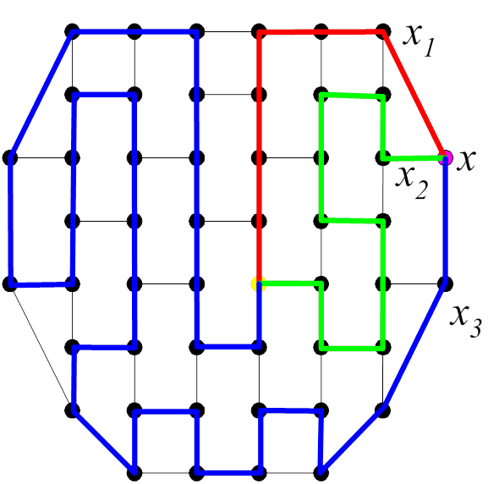

Figure 5-16
Figure 5-17

Slide 18
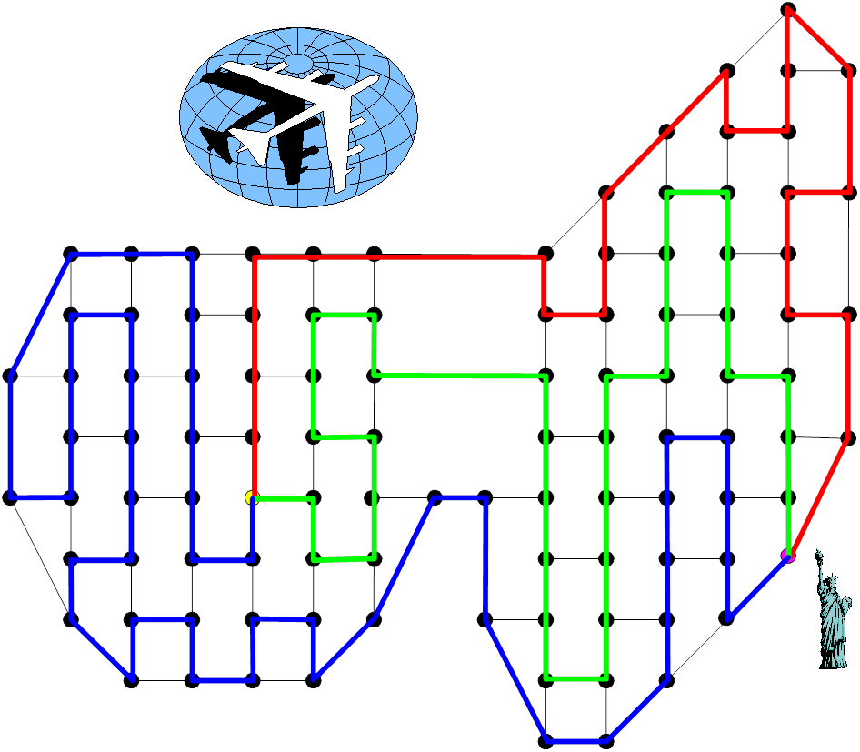

Figure 5-18

Slide 19
Any graph G is globally 3*-connected if and only if its vertex expansion is globally 3*-connected.

Slide 20
Figure 5-19

Slide 21
Category 1 consists the set of all cubic Hamiltonian graphs that are Hamiltonian connected, 1-fault tolerant Hamiltonian, and globally 3*-connected. Category 2 consists of the set of all cubic Hamiltonian graphs that are Hamiltonian connected, 1-fault tolerant Hamiltonian, but not globally 3*-connected. Category 3 consists of the set of all cubic Hamiltonian graphs that are not Hamiltonian connected, 1-fault tolerant Hamiltonian, globally 3*-connected. Category 4 consists the set of all cubic Hamiltonian graphs that are not Hamiltonian connected, 1-fault tolerant Hamiltonian, and not globally 3*-connected. Category 5 consists the set of all cubic Hamiltonian graphs that are Hamiltonian connected, not 1-fault tolerant Hamiltonian, and not globally 3*-connected. Category 6 consists the set of all cubic Hamiltonian graphs that are not Hamiltonian connected, not 1-fault tolerant Hamiltonian, and not globally 3*-connected.

Slide 22
All graphs in Category A are in Category 1: cubic Hamiltonian graphs that are Hamiltonian connected, 1-fault tolerant Hamiltonian, and globally 3*-connected.
Chapter 4 already showed examples of graphs in Categories 5 (cubic Hamiltonian graphs that are Hamiltonian connected, not 1-fault tolerant Hamiltonian, and not globally 3*-connected) and 6 (cubic Hamiltonian graphs that are not Hamiltonian connected, not 1-fault tolerant Hamiltonian, and not globally 3*-connected).
In this chapter, we will give one example each of graphs in Categories 2, 3, and 4.

Slide 23
Figure 5-20 is a graph in category 2: cubic Hamiltonian graphs that are Hamiltonian connected, 1-fault tolerant Hamiltonian, but not globally 3*-connected..
Figure 5-20

Slide 24
We can prove the graph in Figure 5-20 is 1-fault tolerant Hamiltonian and Hamiltonian connected by trial and error.
Not globally 3*-connected.

Slide 25
Figure 5-22 is a graph in region 3: cubic Hamiltonian graphs that are not Hamiltonian connected, 1-fault tolerant Hamiltonian, globally 3*-connected.
Figure 5-22

Slide 26


Not Hamiltonian connected.
Global 3*-connected.
Figure 5-23

Slide 27
Figure 5-24 is a region 4 graph: cubic Hamiltonian graphs that are not Hamiltonian connected, 1-fault tolerant Hamiltonian, and not globally 3*-connected.
Note that the graph in Figure 5-24 is actually the graph found in Figure 4-39. Thus, it is 1-fault tolerant Hamiltonian but not Hamiltonian connected.
Figure 5-24

Slide 28
We can prove that there are not three internal disjoint spanning paths between x and y. Thus, it is not globally 3*-connected. Hence, it is in region 4. However, the proof that “there are not three internal disjoint spanning paths between x and y” is rather tedious. Fortunately, there is an easy proof to show that this graph is not globally 3*-connected. Note that the graph in Figure 5-24 can be obtained by a sequence of vertex expansions of the graph in Figure 5-25. Thus, the graph in Figure 5-24 is globally 3*-connected if and only if the graph in Figure 5-25 is globally 3*-connected.
Figure 5-25

Slide 29
Note that any globally 3*-connected graph is 1-fault tolerant Hamiltonian. Suppose that the graph in Figure 5-23 is globally 3*-connected. Suppose that the vertex x in Figure 5-25 is faulty (see Figure 5-26).
Figure 5-26

Slide 30
Suggested Reading and Possible Future Directions
In [1], Albert, Aldred, Holton and Sheehan first studied cubic graphs with three internal disjoint spanning paths between any pair of vertices. Such graphs are called globally 3*-connected graphs. Later, Kao, Huang, Hsu and Hsu [3] proved that every globally 3*-connected graph is 1-fault tolerant Hamiltonian. Moreover, they proved that there are an infinite numbers of graphs in each region in Figure 5-19. The reader can see the reference section for more information [2].

Slide 31
For possible future directions, we can classify the globally 3*-connected property of some families of graphs. For example, in Chapter 2, we introduced the family of generalized Petersen graphs and the family of cube-connected cycles. We can explore the globally 3*-connected property of this family of graphs. It was proven by Albert, M, Aldred, E.R.L., Holton, D., and Sheehan J. [1] that the graph GP(n,1), with n≥3, is globally 3*-connected if and only if n is odd; the graph GP(n,2), with n≥3 is globally 3*-connected if and only if n=1,2, or 3 (mod 6); and the graph GP(n,3), with n≥7, is 3*-connected if and only if n is odd. Recently, it has been proven that the graph P(n,4), with n≥9 is 3*-connected if and only if n≠12 [3]. For cube-connected cycles, we hypothesize that CCC_{n} is globally 3*-connected if and only if n is odd with n ≥ 5.

Slide 32
Reference:
Albert, M, Aldred, E.R.L., Holton, D., and Sheehan J., On 3*-connected graphs, Australasian Journal of Combinatorics 24 (2001) 193.
Hsu, L.H. and Lin, C.K., Graph Theory and Interconnection Networks, CRC Press, 2008.
Kao, S.S., Huang, H.M., Hsu, K.M., and Hsu, H.H., Cubic 1-Fault-Tolerant Hamiltonian Graphs, Globally 3*-Connected Graphs, and Super 3-Spanning Connected Graphs, to appear in Ars Combinatorica.

Slide 33
cubic graphs
Special families of cubic graphs
Regular graphs
Special families of regular graphs
Examples: Pancake graph
Matching composition of Pancake graphs

Slide 34
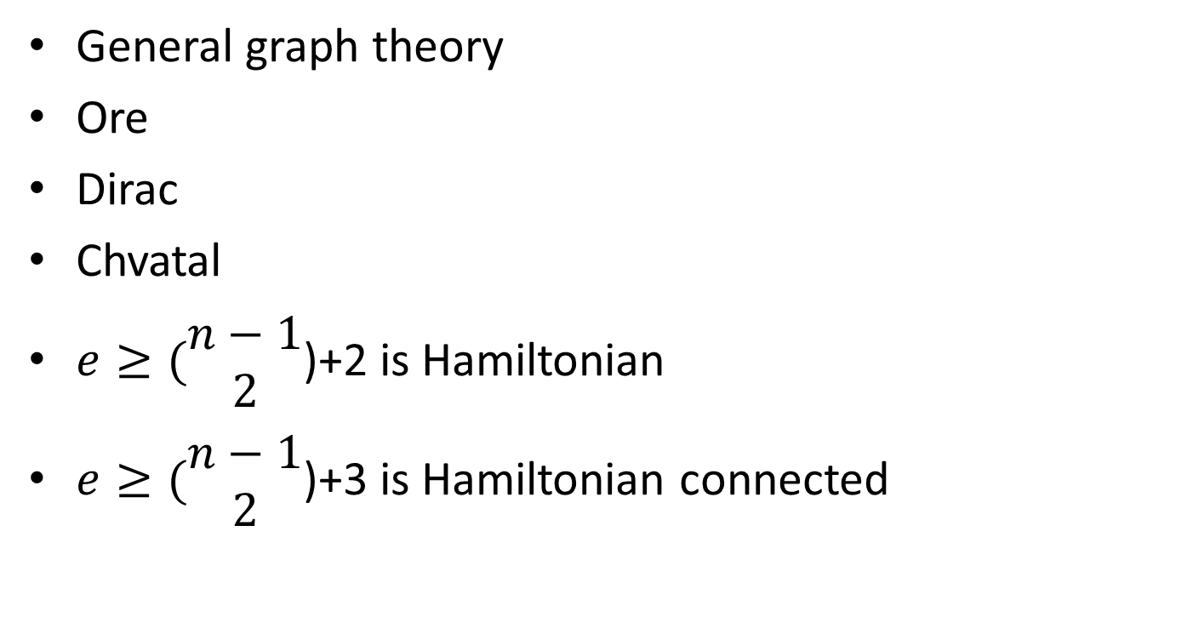
General graph theory
Ore
Dirac
Chvatal
$e≥(\begin{matrix}n−1 \\ 2\end{matrix}$)+2 is Hamiltonian
$e≥(\begin{matrix}n−1 \\ 2\end{matrix}$)+3 is Hamiltonian connected

Slide 35
A note on Diameter of Pancake graph

Slide 36

$e≥(\begin{matrix}n−1 \\ 2\end{matrix}$)+3 is 1*, 2*, and 3*.
$e≥(\begin{matrix}n−1 \\ 2\end{matrix}$)+4 is 1*, 2*, 3*, 4*.
etc

